Slide 1
ER – ENTITY RELATIONSHIP DIAGRAM

Slide 2
ER
1976 proposed by Peter Chen
ER diagram is widely used in database design
  Represent conceptual level of a database system
  Describe things and their relationships in high level
ERD is commonly used to:
  Translate different views of data among managers, users, and programmers to fit into a common framework.
  Define data processing and constraint requirements to help us meet the different views.
  Help implement the database.

Slide 3
Chen’s Notation
Entities
  an abstraction of similar things, e.g. cars, students
  rectangle containing the entity’s name.
Attributes
  common properties of the entities in a entity sets
  oval containing the attribute’s name.
Relationships
  specify the relations among entities from two or more entity sets
  diamond containing the relationship’s name.
Notes:
17

Slide 4
Steps for creating an ERD
Identify entities
Identify attributes
Identify relationships

Slide 5
Entity
Entity - distinguishable “thing” in the real world
  Strong (or regular) entity - entities have an independent existence (e.g. staff)
  Weak entity - existence dependent on some other entity (e.g. next of kin)
“A fundamental THING of relevance to the enterprise about which data may be kept”
What should be an Entity: both tangible & intangible
  An object that will have many instances in the database
  An object that will be composed of multiple attributes
  An object that we are trying to model
What should NOT be an Entity:
  A user of the database system
  An output of the database system (e.g. a report)

Slide 6

An Example

Slide 7

Notations

Slide 8
Notations

Slide 9
Attributes
Entity types have Attributes (or properties) which associate each entity with a value
from a domain of values for that attribute
“describe property or characteristic of an entity ”
Attribute:
  property or characteristic of an entity
  A descriptor whose values are associated with individual entities of a specific entity type
  look for descriptions, characteristics, and properties of entity
Both entity sets and relationships can have attributes
Entity: Employee
Attributes:
  Employee-Name
  Address (composite)
  Phone Extension
  Date-Of-Hire
  Job-Skill-Code
  Salary
Notes:
18

Slide 10
Classes of attributes
Simple attribute
Composite attribute
Derived attributes
Single-valued attribute
Multi-valued attribute
Notes:
5

Slide 11

Another Example

Slide 12
Example - “Movie Database”
Entity:
  Person
Attributes:
  SS#: “123-45-6789” (single-valued)
  Cell Phone: “(661)123-4567, (661)234-5678” (multi-valued)
  Name: “Admed Khan” (composite)
  Address: “123 Main Str., LA, CA” (composite)
  Birthdate: “1-12-90” (simple)
  Age: 37 (derived)

Slide 13
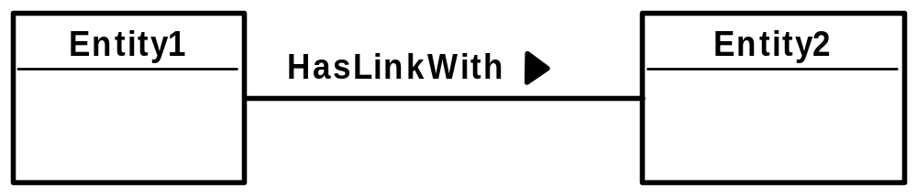
Relationships
A relationship is
“.. An association among entities (the participants)..”
Relationships link entities with each other
Name: verb, capital start letter, arrow indicates direction in which verb makes sense

Slide 14
Relationships: constraints
The degree of a relationship type
  binary (connects 2 entity types)
  unary/ recursive (connects 1 entity type with itself)
  complex (connects 3 or more entity types)
    Ternary (connects 3)
Relationship constraints - cardinality
  one to one (1:1)
  one to many (1:m)
  many to many (m:n)
Relationship constraints – participation
  full/mandatory
  or partial/optional
Degree
Multiplicity

Slide 15

Relationship Example

Slide 16

Attribute of A Relationship Set

Slide 17

One-One and One-Many

Slide 18

Many-one and many-many

Slide 19

1- many

Slide 20
Many - 1

Slide 21
Many - many

Slide 22

Alternative Cardinality Specification

Slide 23
Note on Mapping Cardinality
Both many and 1 include 0
  Meaning some entity may not participate in the relationship

Slide 24

Total Participation
When we require all entities to participate in the relationship (total participation), we use double lines to specify
Every loan has to have at least one customer

Slide 25

Self Relationship
Sometimes entities in a entity set may relate to other entities in the same set. Thus self relationship
Here employees mange some other employees
The labels “manger” and “worker” are called roles the self relationship

Slide 26
More examples on self-relationship
People to people
  Parent – children
  Manager – employee
  Husband – wife
Word to word
  Root – synonym

Slide 27

Ternary Relationship

Slide 28
Keys
A super key of an entity set is a set of one or more attributes whose values uniquely determine each entity.
A candidate key of an entity set is a minimal super key
Although several candidate keys may exist, one of the candidate keys is selected to be the primary key.

Slide 29
Key Examples
Suggest super keys for the following entity?
What are the candidate keys?
Primary key?
author
name
death
birthday
description

Slide 30
Design an ER Diagram
Design a database for an on-line reservation system for microscopes in material science lab
There are two types of users: microscope administrators and microscope end users
Each microscope is located in a specific lab
Each request is assigned to an administrator who can authorize or deny the request
Using of some microscope requires the presence of an administrator
Time is divided into 1 hour slots. Each reservation can only take one or more time slots

Slide 31
Can We Decompose a Ternary Relationship?
Some relationships that appear to be non-binary may be better represented using binary relationships
  E.g. A ternary relationship parents, relating a child to his/her father and mother, is best replaced by two binary relationships, father and mother
    Using two binary relationships allows partial information (e.g. only mother being know)
  But there are some relationships that are naturally non-binary
    E.g. works-on, why?

Slide 32
Converting Ternary to binary
In general, any non-binary relationship can be represented using binary relationships by creating an artificial entity set.
  Replace R between entity sets A, B and C by an entity set E, and three relationship sets:
1. R_{A}, relating E and A 2.R_{B}, relating E and B
3. R_{C}, relating E and C
  Create a special identifying attribute for E
  Add any attributes of R to E
  For each relationship (a_{i} , b_{i} , c_{i}) in R, create
1. a new entity e_{i} in the entity set E 2. add (e_{i} , a_{i} ) to R_{A}
3. add (e_{i} , b_{i} ) to R_{B} 4. add (e_{i} , c_{i} ) to R_{C}

Slide 33

Converting Ternary to binary

Slide 34
Weak Entity Set
Some entity sets in real world naturally depend on some other entity set
  They can be uniquely identified only if combined with another entity set
Example:
  section1, section2, … become unique only if you put them into a context, e.g. csce4350

Slide 35

Weak Entity Set Notations
Double rectangles for weak entity set
Double diamond for weak entity relationship
Dashed underscore for discriminator

Slide 36
Specialization
A lower-level entity set inherits all the attributes and relationship participation of the higher-level entity set to which it is linked.
A lower-level entity set may have additional attributes and participate in additional relationships

Slide 37


Slide 38
Specification
Disjoint
Completeness constraint (use double lines)
  total : an entity must belong to one of the lower-level entity sets
  partial: an entity need not belong to one of the lower-level entity sets

Slide 39
Design Considerations
Use of entity sets vs. attributes
  Whether we want to keep additional information
Use of entity sets vs. relationship sets
  Actions among entities are usually represented by relationships
Binary versus n-ary relationship sets
  N-nary relationships are usually more natural for actions among entity sets
Weak entity set vs. strong entity set
Generalization

Slide 40
ER Practice Again
Design an ER diagram for an online music store. The database will contain at least the following concepts: songs, artists, bands, albums, and genres.
State your design assumptions you make to support design decisions. Be sure your assumptions are reasonable.

Slide 41
Best Practice Guide for ER Design
Use of entity sets vs. attributes
Use of entity sets vs. relationship sets
Binary versus n-ary relationship sets
Weak entity set vs. strong entity set
  Choose the natural one
Generalization
  If specialized entities need to keep additional information and participate in additional relationships

Slide 42
ER for Banking Enterprise
Description handhout

Slide 43
Read ER Diagrams
Following are some ER diagrams grabbed from the web
Read to understand/criticize

Slide 44
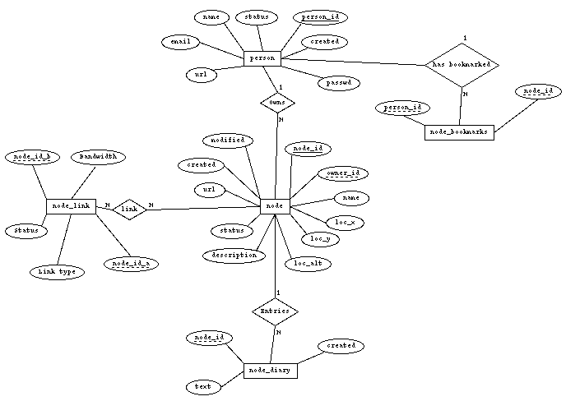
?
?
?
?
?
?
?
?
?

Slide 45
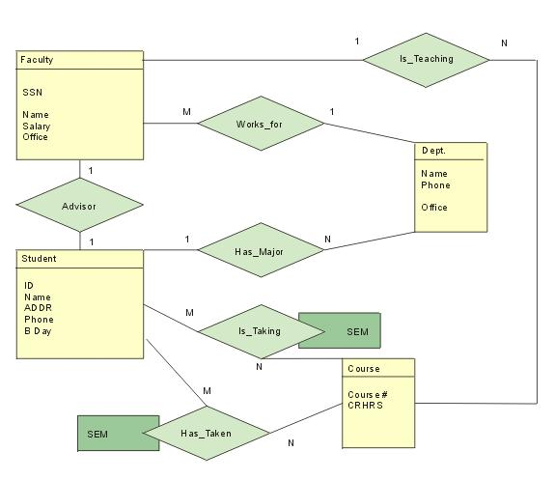
?
?
?
?
?

Slide 46
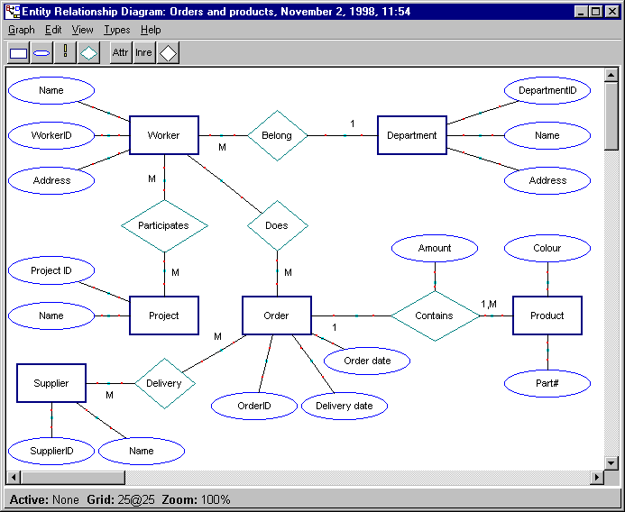
?

Slide 47
